Slide 1


ROOM-MONITORING SYSTEM
Ali Ismail

Slide 2

ABOUT ME
Name : Ali Ismail
Age : 16
Location : Lebanon
Age Group : 15-18 group
Email : ali.ismail@rhhs.edu.lb
Goal : Goal 3-Good health & Well-being

Slide 3

PROBLEM
Indoor smoking in restaurants and coffeeshops can be harmful to the nonsmokers working or sitting nearby (Passive smokers).
The smoke coming from smoking (cigar, vape, hookah) increases the chance of virus infection in indoor areas due to the decrease of humidity and increase or decrease of temperature in the room.

Slide 4
ANNUAL CIGARETTE SMOKING-RELATED MORTALITY IN THE UNITED STATES, 2005–2009
https://www.cdc.gov/tobacco/data_statistics/fact_sheets/health_effects/tobacco_related_mortality/index.htm

Slide 5

SOLUTION
An effective ventilation system using all possible resources while monitoring the room humidity, temperature, and smoke levels to ensure maximum efficiency and protection.

Slide 6

PROJECT IDEA
A room-monitoring system made by a chain of micro-bits that monitor the rooms, especially where there is smoking.
My system monitors the levels of humidity, temperature, and smoke (nicotine), and change the room settings based on the sensors’ data to create a healthy and decontaminated area.

Slide 7

Design (1)
It is a room-monitoring system made by a group of sensors connected to a monitoring panel where the average of each aspect is calculated to be displayed.
This system monitors the room temperature, humidity level, and smoke level by a group of sensing units distributed in the room. Each room contains at least 2 units.

Slide 8
Design (2)
The monitoring panel calculates and displays the average room temperature, humidity level, and smoke level.
This panel alerts the room workers if one of the monitored aspects becomes dangerously high or low to take the right action like opening windows or turning on the ventilation system to reduce the levels of the monitored aspects.
The alerting levels are based on the seasons or the types of common viruses in the area.

Slide 9
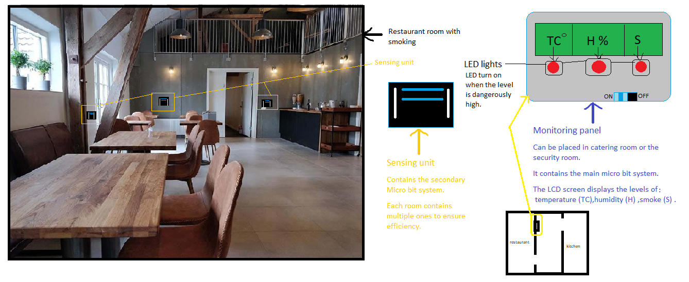

Slide 10
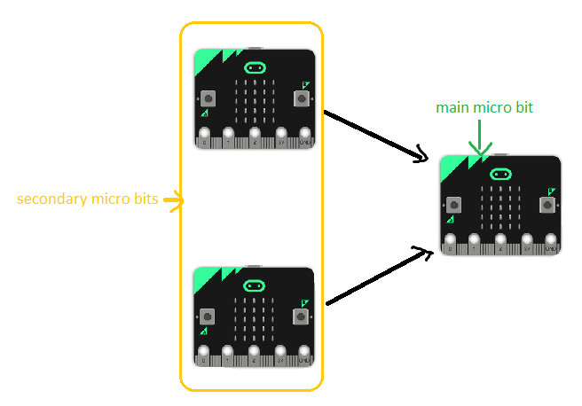
Micro bit network
The network is formed of three micro bits(smallest network example):
2 secondary micro bit.
1 main micro bit.

Slide 11
System Settings
The monitoring panel alerting levels are based on the seasons or the types of common viruses in the area.
The humidity alert level is under 50% because viruses live longer in less-humid air.
The smoke alert level is under 20% because smoke is dangerous with minimal contact .
The settings are divided to two settings:
-winter settings
-summer settings
Settings | Temperature | Common Viruses
Winter settings | <22-Degree Celsius | Cold-Flu-RSV…
Summer settings | >22-Degree Celsius | Coronavirus…

Slide 12
Micro bit Network
Connected to main micro bit
Connected to humidity sensor, and smoke sensor
It uses the built-in temperature sensor
Secondary micro bit:
Secondary micro bit is connected to a temperature sensor, humidity sensor, and smoke sensor. These sensors and the micro bit create the sensing unit:
  Humidity sensor at port 0.
  Temperature sensor built-in.
  Smoke sensor at port 2.

Slide 13
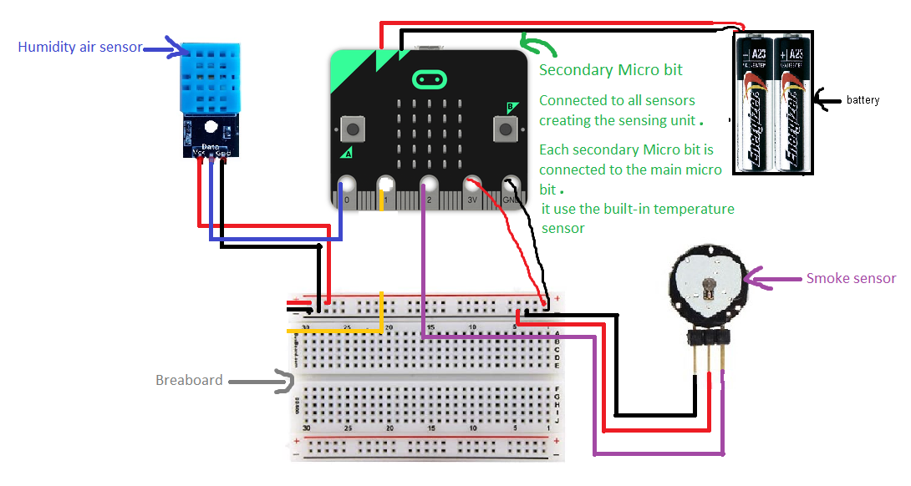

Slide 14
Micro bit Network
Main micro bit:
Connected to L2C LCD 1602 Display system
Receive signals form all secondary micro bits
Main micro bit has the role of calculating the average room temperature, humidity level, and smoke level. These levels come from all secondary micro bit sensors and then are used to calculate the average of each monitored aspect.
Main micro bit displays the levels of monitored aspects using L2C LCD 1602 Display system.

Slide 15
Micro bit Network
Main micro bit: Connected to 3 red lights
Alert system is based on the average of each monitored aspect:
  If the average of temperature is < Degree Celsius or >22-Degree Celsius ➔turn on red led 1 (port 0)
  If the average of humidity is <50% ➔ turn on red light 2 (port 1)
  If the average of smoke is >20% ➔ turn on red light 3 (port 2)

Slide 16
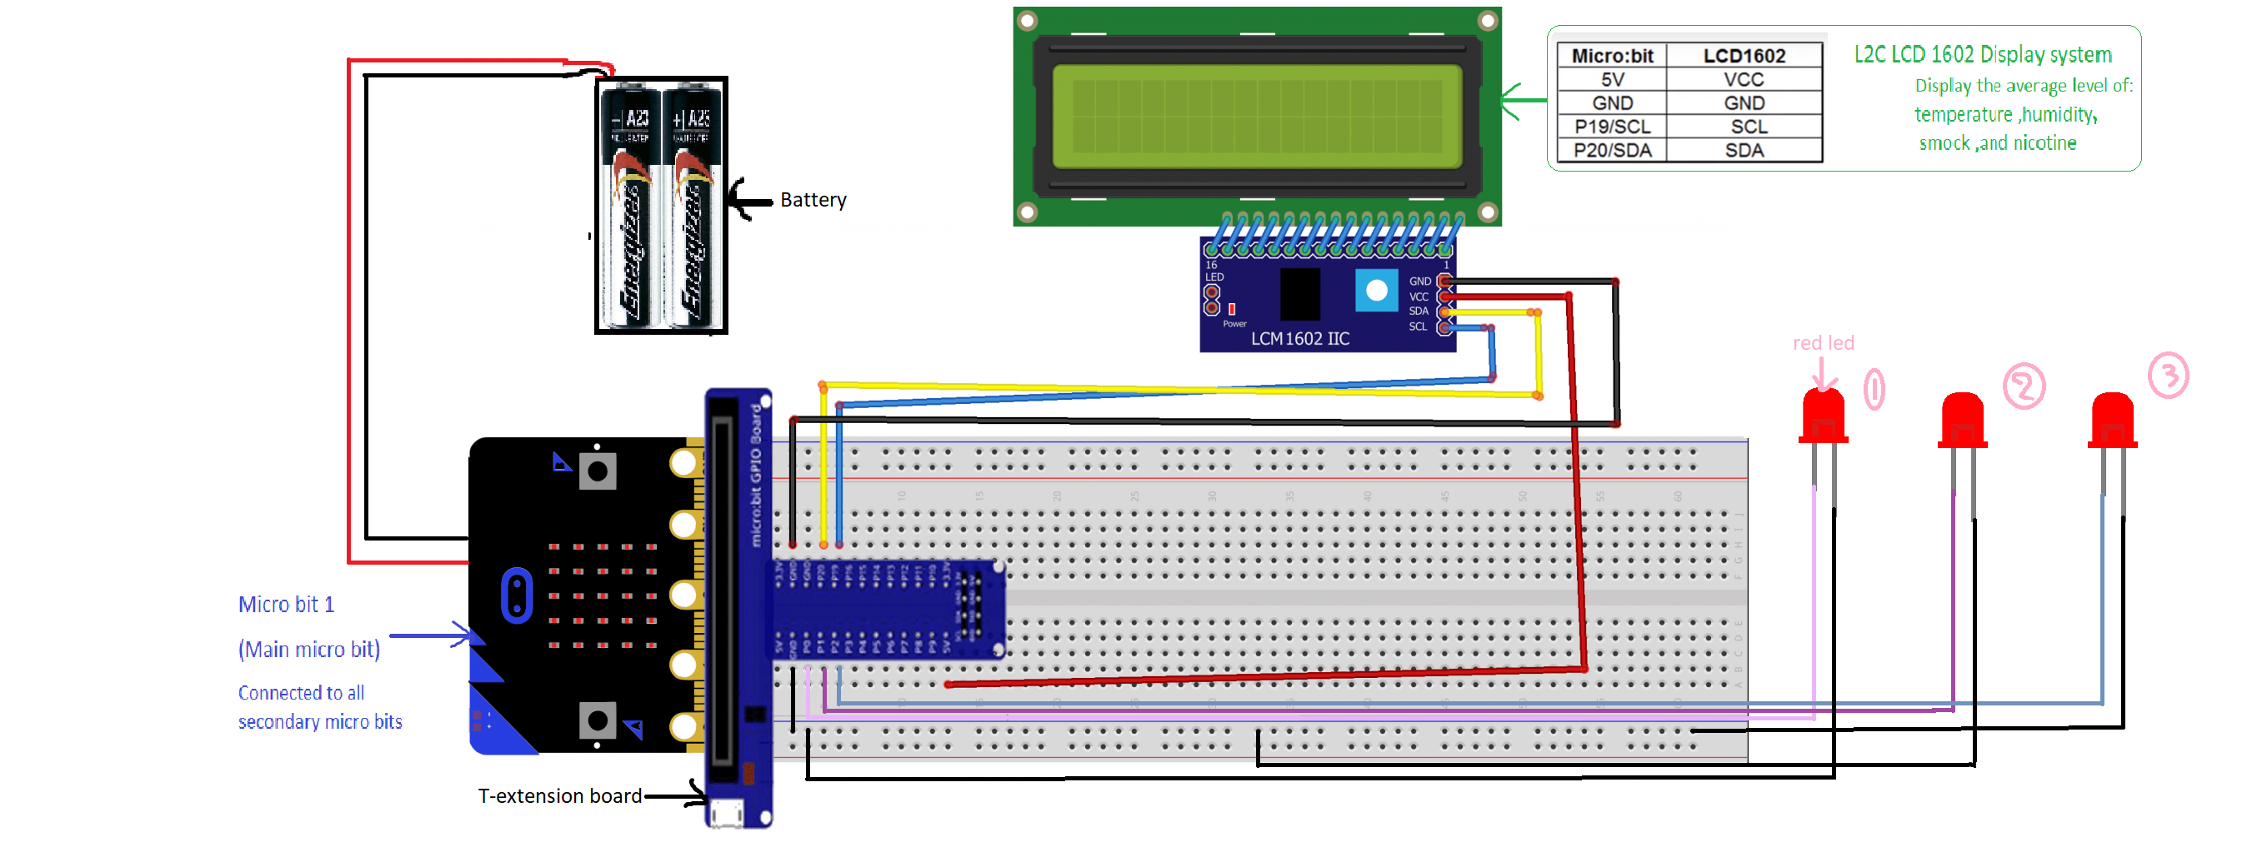

Slide 17
Reaction Guide
After getting an alert from the system an action needs to be taken. Then comes the role of the person monitoring on the panel to follow the reaction guide to take the write action.
Temperature Alert
Adjust the AC temperature
Smoke Alert
Turn on the ventilation system
Humidity alert
Open windows or turn on AC

Slide 18

Code
The number of secondary micro bits used is proportional to the room size. For example, we will describe only two secondary micro bits and one main micro bit.
Secondary micro bit 1 will send signals each 5 minutes
Secondary micro bit 2 will send signals each 6 minutes

Slide 19

Future Works
Advance the sensing system with more chemical product sensors like nicotine and monoxide Carbone….
Automating the reactions using AI to take the preferred action by analyzing the environment (if it's cold outside it doesn’t open the windows) and the situation (calculated levels).
Connecting the system to an app so it becomes accessible by all the staff not only the worker in the control room.
Upgrade the system to have more implementations like in hospitals and houses….

Slide 20
References
Famoroti, T., Sibanda, W., & Ndung'u, T. (2018). Prevalence and seasonality of common viral respiratory pathogens, including Cytomegalovirus in children, between 0-5 years of age in KwaZulu-Natal, an HIV endemic province in South Africa. BMC pediatrics, 18(1), 240. https://doi.org/10.1186/s12887-018-1222-8

Slide 21


